Slide 1
ON CHILDREN
-KahLil Gibran
Presentation by
Chrisma
Darshan
Dharani
Deon
Divya

Slide 2
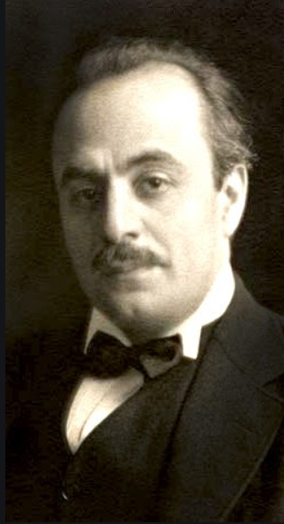
About the poet
Kahlil Gibran was born on 1883 and had his last breath on 1931.He was a Lebanese-American artist and poet. His poems are considered ‘poetic essays’, as they do not adhere to the usual versification. ’The Prophet’ is his best known work.

Slide 3
Poem in detail
And a woman who held a babe against her bosom said ,”Speak to us of children .”
And he said:
Your children are not your children
They are the sons and daughters of life’s longing for itself
They come though you but not from you,
And though they are with you ,yet they belong not to you.
You may give them your love but not your thoughts
For they have their own thoughts
You may house their bodies but not their souls
For their souls dwell in the house of tomorrow, which

Slide 4
you cannot visit, not even in your dreams
You may strive to be like them, but seek not make them like you.
For life goes not backward nor tarries with yesterday
You are the bows from which your children as living arrow are sent forth
The archer sees the mark upon the path of the infinite, and he bends you with his might that his arrows may go swift and far.
Let your bending in the archer’s hand be for gladness;
For even as he loves also the bow that is stable

Slide 5
Summary of the poem
Thought the poem “On Children” the poet is trying to guide the parents on parenting by saying that their love for their children should be without any conditions or expectations from their children.in this poem a mother approaches a prophet to know about his perspectives on children .he replies by saying that your children are not your children. The poet here is trying to bring the concept of life’s creations and its aspirations Contrary to the accepted notion of parents making claims, the prophet says that they are just biological means and the children do not belong to them. Children live with their parents but they do not belong to them. Parents may give their love to children and they should never force their ideas on children. Children have their own ideas and identity. The Prophet says that parents have a biological bond with the children now. However, souls of the children lie in future which cannot be reached by parents. So, the advice here to parents is they shall not pressurise children with their thoughts.

Slide 6
Parents are suggested rather to follow the ways of children than trying to change children to be like them. The Prophet says that this is because Life keeps moving forward and never retracts. He further substantiates his philosophy by making metaphorical references. Parents are compared to bows and children are compared to arrows. The archer, God himself sets His eyes on the target which is infinite and sends His arrows swift and far by bending the bow with His might. Parents should take delight in this act of bending that involves great strain. The Prophet strikes a perfect conclusion by referring to the Law of creation where God loves both the bow and the arrow as they complement each other on Life’s infinite journey. Kahlil Gibran stresses here the importance of children’s individual views and independent ideologies not influenced by their parents.

Slide 7
Questions
And a woman who held a babe against her bosom said, ”Speak to us of children.” And he said: Here 'he' Refers to
Whom does the word bows refer to ?
What does the phrase ‘living arrows’ refer to?
Who is the archer in the poem?
Whom does God use as his instrument to send living arrows to the earth?
Why does god bend the parents with all his might?
What brings children to the earth?
Why shouldn't parents give their thoughts to their children?
Who dwell in the house of tomorrow?
According to the prophet, what may be given to the children?

Slide 8
THANK YOU

